Slide 1
What’s in a database?
Biologics PK -- How to get started
Boris Grinshpun
June 21st, 2019

Slide 2
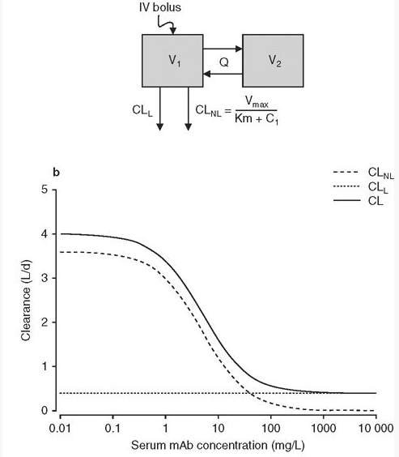
Many parameters involved in popPK analysis
Independent | Measured | Estimated
Dose | Concentration in central compartment | Clearance rate
 |  | Half life
Method of administration |  | Bioavailability
Study design |  | Volume
 |  | Other rate constants
Covariates: weight, surface area, age, etc
Dirks, N. L. & Meibohm, B. Clin Pharmacokinet (2010).

Slide 3
Useful information to include …
Age
Weight
Sex
Gender
Concomitant medication
…
Number of participants
Trial 1
Drug
Independent parameters
…
Trial n
Measured parameters
PK profiles
Estimated parameter
Model Used
Values
Preclinical trials
Other nice things to have would be structure, formulation, etc if possible

Slide 4
Starting with human data
Determining completeness
Formulation,
structure,etc
Covariates
Multiple independent parameters
Measured parameters,
model description
Parameter Estimates (half life, F)
Decreasing likelihood of obtaining from a single publication

Slide 5
Determining Quality (i.e. Tiers)
Tier 1:
Population PK analysis performed, including IV data (highest priority)
Reliable estimate of non-linear systemic CL and its variability is available (highest priority)
Confidence in data is such that it would be used in a PK/PD model as 'real' data
Tier 2:
Population PK analysis performed, without IV data (only sub-cut)
Good estimate of CL/F and terminal half-life; potential scenario(s) = not good estimate of F but perhaps good understanding of half-life
Target-mediated effects or non-linearity highlighted
Any non-compartmental analysis (NCA) data which includes figures showing PK profile over time (provide the option to extract further data if needed)
Tier 3:
NCA parameters without figures showing PK profile over time (certain degree of uncertainty around parameters)
Only summary data such as AUC, half-life, Cmax or F.
Human data
Confidence in data is such that it would not be used in a PK/PD model
Completeness Pyramid
Formulation,
structure,etc
Covariates
Multiple independent parameters
Measured parameters,
model description
Parameter Estimates (half life, F)

Slide 6
Assigning a score
Automation
Curation
COMPLETENESS + QUALITY TIER → SCORE
This needs to be worked out!
Maybe just provide a score for each
(i.e. Completeness level/percentage + Tier level)
Completeness may be possible via AI approaches with some curation but well defined terminology. Literal information grab.
Quality requires expertise
Initial examples are necessary to produce a clear picture and enable meaningful contributions

Slide 7
Proposed Steps
Define completeness profiles and assign a level/percentage based on agreed upon minimum “key” ingredients:
For a single specific study, what information should we have.
For multiple studies, what should we include per study
Where should there be a single value vs a range of values by study?
Assign a tier, experience based. Will be correlated but separate from completeness.
Consult database experts for data storage, display, and retrieval

Slide 8
Previously ranked Tier 1 papers (examples)

Slide 9
doi:10.1111/j.1365-2125.2011.03964.x
British Journal of Clinical Pharmacology 72:2 (2011) 270-281
SIRUKUMAB
Parameter Estimates | Half life 18.5-29.6 days CL, Volume distribution, Cmax, etc Non-compartmental analysis and two compartment model
Measured parameters | Concentration time profiles
Multiple independent parameters | IV dose 0.3,1,3,6,10mg/kg
Covariates | 45 individuals, single study, healthy individuals only Gender, Age, Race, Weight
Formulation, structure, etc Additional metadata | Human, anti-IL-6 Adverse effects info provided Lupus erythematosus, RA, chronic inflammation, etc

Slide 10
doi:10.1002/psp4.12160
CPT Pharmacometrics Syst. Pharmacol. (2017) 6, 249–257;
BENRALIZUMAB
Parameter Estimates | Half life = 18 days Volume distribution = 52-93 mL/kg CL = 0.3232 L/day F, CL, ka, etc. Two-compartment w first order elimination 8 week dosing schedule proposed
Measured parameters | Effective dose range: >0.3 mg/kg Concentration/time profiles
Multiple independent parameters | 25-200 mg (SC) 0.03 – 3 mg/kg dosing range (IV) Administration rates included
Covariates | 200 total individuals across 6 studies (2 healthy, 4 asthma) Volunteers from Japan and N.A. with exact # participants. Age, Body weight, smoking status, BMI, Gender, Race
Formulation, structure, etc Additional metadata | Humanized, afucosylated, anti-IL-5R, asthma, IgG1, Kappa chain, ADCC activity

Slide 11
A few additional papers

Slide 12
Additional papers
https://www.ncbi.nlm.nih.gov/pmc/articles/PMC5270291/ , CPT Pharmacometrics Syst Pharmacol. 2017 Jan; doi: 10.1002/psp4.12139
https://www.sciencedirect.com/science/article/pii/S0149291803801649?via%3Dihub, Clin Therapeutics. 2003 June; https://doi.org/10.1016/S0149-2918(03)80164-9
https://www.ncbi.nlm.nih.gov/pmc/articles/PMC6394489/ , Cancer Chemother Pharmacol. 2019; doi: 10.1007/s00280-018-3728-z
https://link.springer.com/article/10.1007%2Fs40262-019-00765-1, Clin Pharmacokinet. 2019 May; https://doi.org/10.1007/s40262-019-00765-1 [subcutaneous only] – Tier 2
Initial key search terms used are quite simple:
Population pharmacokinetics
Intravenous
Compartment model
Half-life

